Slide 1
Creekside Football Mission Statement:
Creekside High School Football will train & develop coaches & players to be leaders who have a great amount of TOUGHNESS, a great ATTITUDE, a determined WORK ETHIC, are COMMITTED and who CARE for others, both in football and every other aspect of their life.

Slide 2
Creekside Football Foundations
TOUGHNESS
ATTITUDE
WORK ETHIC
CARING
COMMITMENT

Slide 3
Our Process
1st Quarter: December/January/February
Focus is Strength & Mass Gain – Lift 4 Days – 1 Day of Yoga/Core
2nd Quarter: March/April
Focus is Power w/ Speed & Agility – Lift 3 Days – 2 Days of Speed/Agility
3rd Quarter: April/May (Spring Football)
20 very physical practices with in-season strength training + Spring Game.
4th Quarter: June/July (Summer)
Preparing the team for the season – 4 Days a week of Strength, Speed and Agility, Conditioning and Football Fundaments/Skills and Scheme
In Season: Used to maintain strength, works within our weekly practice schedule.

Slide 4
2020 Where We Are…
Year | Body Weight | Clean Max | Bench Max | Squat Max | Total
2018, May | 177 | 183.8 | 174.6 | 266.9 | 619.6
2019, February | 188 (+11) | 195.3 (+11.5) | 188.9 (+14.3) | 291.1 (+24.2) | 670.0 (+50.4)
2020, February | 184 (-4) | 200.9 (+5.6) | 209.4 (+20.5) | 300.4 (+9.3) | 708.6 (+38.6)
Each athlete has their own progression based on their strength
We modify various lifts for injuries and the need of each athlete

Slide 5
2020 Where We Are Going…
We will continue to build on our mission statement and develop and care for our young men through our training and interactions with them.
Family Action Plan
Communicate (player & family, player & coaching staff) and Celebrate the work!
Grades (we monitor weekly)
Weigh-Ins (we monitor weekly)
Max Out Numbers (monitored after each phase of training)
Injuries (Coaches & Ryan Boyer, ATC)
Together we must try to develop young men who can advocate for themselves. Please have your son start the conversation and then feel free to follow up or clarify with Coach McIntyre. All questions should be directed to Coach McIntyre.
Please keep everyone on the same page.

Slide 6
2020 Info
Priorities...
1) Faith/Family
2) Academics
3) Creekside Extra Curricular Activities
4) Creekside Football
5) Everything Else
Attendance
Commitment is NOT Convenience
Banquets/Dentist/Etc.
Class Schedule for next year:
Weights Classes will be 1st Period & 7th Period.
Our Admin works with us to get all the kids in the classes together. This allows us to build a team year round. If there is any conflicts in your sons schedule, I will discuss it with them directly in the summer before a decision is made.

Slide 7
2020 Info
Required Paperwork: Each student athlete must have a completed profile on www.athleticclearance.com on file to participate. Sign up for “Spring Football”
CHS will be holding physicals on 4/4 at 9, 10 or 11am. The cost is $10. This is highly recommended for all CHS Football Players.
Paperwork can be found on CHS Athletics Website.
Contact Info & Communication:
New team members… Please click the link on www.creeksidefootball.com to be added to our email list
Twitter - @Creekside_fb & @CHSFLRecruiting
Instagram - @Creekside.Football
Facebook – “Creekside Football Page”
Remind – used for coach/player communication (parents cannot join due to 150 person limit)

Slide 8
Currently Going On…
Currently going on…
7v7 on Friday Mornings at 8am – Cost is $45
OL/DL Conditioning Thursday Mornings
“If you do more than expected you’ll likely accomplish more than what everyone expects.” – Jon Gordon
Yearly Calendar… Is always available at www.CreeksideFootball.com/Calendar
Week after School and week before July 4th are off.
The week after July 4th will be Varsity only due to team camp

Slide 9
Spring & Summer 2020
Equipment
Each player must provide there own girdle and cleats
Weight room/Conditioning attire: Grey Shirt & Red Shorts
Leggings & Sleeves: Plain White or Plain Black (Match our Pants/Socks)
Baker’s Sports - Team Store closes Sunday 3/8
Riddell, Xenith & Schutt Team Stores will be emailed – Completely Optional

Slide 10
Spring 2020
Practice begins Monday 4/27 – Spring Game home against Clay High School on Friday 5/22 at 6pm.
Every position is up for grabs each day, especially in the spring. Every player is constantly being evaluated.
We will not be able to dress all players.
Varsity & JV as well as depth charts will begin in the spring. Evaluations will continue into the summer and into the fall.
Some Sophomores/Freshman may work play/work with the Varsity all Spring and Summer but not play varsity in the fall. Our rule for Sophomores/Freshman is they must play 25% of the Varsity snaps and all Special Teams.
“Red & Black” Scrimmage from 5:30 to 7:30 on Thursday 5/7.

Slide 11
Summer 2020
Summer Football Conditioning starts Monday 6/3 – Cost is $150.
If you pay before spring break the cost will be $125.
Cost includes a PE locker for the entire school year
Team Camp for all Varsity Players: at Valdosta State University: July 7th – 9th cost is $200. Checks made out to “Creekside High School” and payment must be made in full by 6/3.
7v7 every Wednesday in the summer vs local schools. These events & dates will be communicated to the team.

Slide 12
Fall 2020
We have scheduled 8 games for both of our JV Teams. This is to give each athlete to opportunity to play the most snap possible.
We will communicate with each player as to the team they will be on. We try to keep kids on the same team all year but that doesn’t always happen.

Slide 13
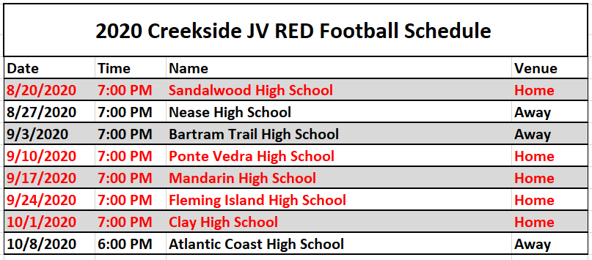
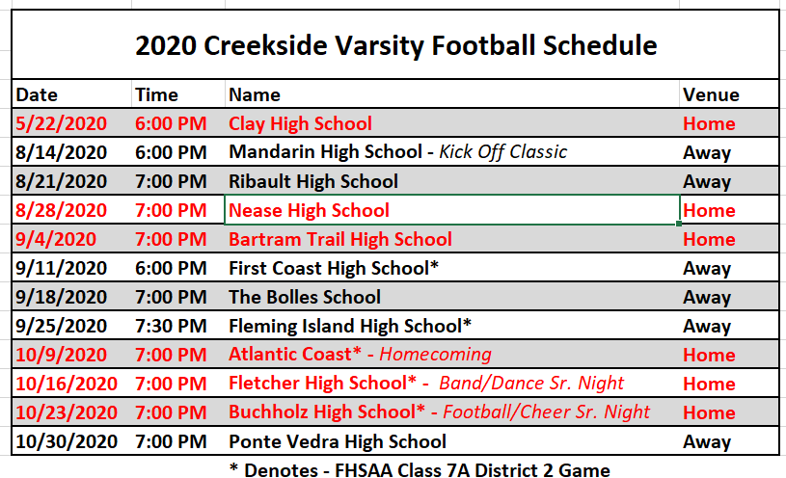
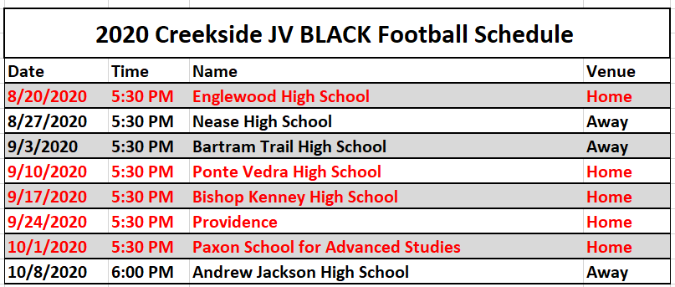

Slide 14
Fundraising
Mission: To provide our football team and players with the best equipment and experience possible.
Fundraisers: We will have 2 fundraisers
Summer/Fall: Score Card Sales
Winter: Red & Black Gala (Need Help)
Any other Fundraisers will go directly back to the player in gear or fees (TPC, etc.)
Sponsorships: We are providing partnering and marketing opportunities for local businesses.

Slide 15
2020 Costs
Money will never be a factor for an athlete’s participation
Spring 7v7 is $45 – Due ASAP
Summer Conditioning is $150 ($125 if paid before Spring Break) – Due by 6/3
Varsity Team Camp is $200 – Due by 6/3 - TPC can offset this cost
Fall Team Fees - $400
This fall each athlete will be able to sell all 20 Score Cards which will cover all Fall Team Costs.
$100 Athletic Department Fee
$100 Team Meal Fee
$50 for Equipment/Team Needs
$150 for Daily Nutrition (.75 per day and 200 Days per year)
TPC Tickets can offset this cost

Slide 16
Touchdown Club
Mission: To provide each of our student athletes with the best possible high school football experience.
Joining: Next meeting is Monday 3/30 at 7:00pm in the CHS Library.
We will be discussing/finalizing Pre-game Meals, Sponsorships, Fundraisers and other way for parents to be involved.
Everyone is welcome. We are looking into possibly electing a board and/or having a president of the Touchdown Club.
This is the best way to be involved in the Creekside Football Program as a parent.

Slide 17
Recruiting
Academics: Great students have more options.
Services: We do not recommend paying for any recruiting service. Use your resources to visit colleges.
Urgency: This is a once in a lifetime opportunity, be aggressive, develop relationships with each coach. You get out of recruiting what you put into it.
Communication: Please keep the coaching staff informed on any and all contact with any colleges/universities. Always speak with the coaching staff about your plans for visiting any college or going to a camp. Please contact Coach McIntyre about anything recruiting.
Info: Our recruiting power point can be found at www.creeksidefootball.com/recruiting

Slide 18
Nutrition
QUANTITY
MACRONUTRIENT COMPOSITION
Natural foods are generally superior in terms of their support of athletic performance and basic health. This leaves meat, fish, eggs, vegetables, fruits, nuts, certain oils, and possibly certain dairy products as the types of foods that will ideally comprise the bulk of the athlete's intake.
PROCESSED FOODS CANNOT COMPETE WITH THE NUTRITIONAL DENSITY OF NATURAL FOODS
TO MAINTAIN: eat 17 cals / lb of BW
TO LOSE: eat 14 cals / lb of BW
TO GAIN: eat 20 cals / lb of BW
CARBOHYDRATE
Varies among athletes and periods of training
(vegetables, fruit, potatoes, rice)
PROTEIN
Should be considered the first priority
(meat, fish, high-quality eggs)
BASELINE: 1 gram / lb of BW
FAT
Absolutely necessary to support health
(nuts and seeds, avocado, olive oil)
QUALITY
This is the total amount of food being eaten per day, measured in calories (cals). This gives us a measure of the amount of ENERGY being taken in. Manipulation of the following guidelines can produce the most dramatic changes in the body such as a weight gain and weight loss.
HYDRATION
Drink 1 oz of water / lb of body weight

Slide 19
THANK YOU FOR COMING
#UKNIGHTED2020
#WorkToWin

