Slide 1
Recruiting 101
Trying to Make Sense of the Process

Slide 2
Who plays a role in Recruiting?
College/Universities – Looking for the biggest, fastest, strongest, and brightest athletes they can find to help them win and represent their institution in a positive light.
High school prospects – Take care of your academics. Give yourself the ability to play well when given the opportunity based on your work in the weight room and speed/agility trainings. Seek out realistic opportunities to play on the next level given your ability and skill set.
Prospect Parents – Educate yourself on the process, have realistic attainable expectations based on your child's ability and skill set. Facilitate opportunities to visit schools and summer camps. Enjoy the process and time with your son. Do not let recruiting become stressful for anyone.
High School Coaches – Provide an atmosphere conducive to the success and advancement of your players. Educate parents and players about what their abilities and opportunities are. Promote the athletes to colleges and universities and foster those relationships.

Slide 3
3 Guidelines for Prospects
Show respect to everyone. We have had coaches ask janitors, guidance counselors, other teachers about potential recruits. Use phrases like Yes Sir/Ma’am, No Sir/Ma’am, it will open doors for you.
You are NOT entitled to anything in this world, if you want it you will have to work for it.
Dress for success and speak with confidence. Your appearance and demeanor says more about you than you know. Perception is reality you are ALWAYS being evaluated.

Slide 4
3 Guidelines for Parents
You are being evaluated too. Your conversations with coaches, interactions with your child, everything.
It is ok to ask any and all questions you have. You have to feel good about your son spending 5 years at this institution.
Be involved and guide/assist but don’t drive the process.

Slide 5
Division I FBS
85 Full Scholarships Per Team
FBS Schools include UF, FSU, FAU, USF, FIU, etc.
REQUIREMENTS: Graduate & Complete 16 Core Classes
7 of the 10 core courses must be in English, math or science.
Earn a CORE-COURSE GPA of at least 2.300 – Math, English, Science, Social Studies, Foreign Lang. – Electives/PE DO NOT count!
4 yrs of English & 3 yrs of Math (Alg. 1 or Higher)
2 yrs of Natural or Physical Science
1 extra yr of English, Math or Nat. or Phys. Science
2 yrs of Social Science
4 yrs of extra Core courses
Earn an ACT/SAT sum score matching your core-course GPA on the Division I sliding scale. http://www.ncaa.org/student-athletes/future/test-scores
FBS programs offer 85 full academic scholarships. These scholarships pay for all costs associated with attending a College or University.

Slide 6
Division I FCS (63 Scholarships Per Team)
FCS schools include Kennesaw St, Mercer, Wofford, Furman, Etc.
These Schools can split up athletic scholarships into partial packages or some D2 will have no scholarships – Athletic Ability along with academics will dictate the value of these packages.
These scholarships are awarded on yearly basis and can change each year depending on a player’s value to the program.
Division II (36 Scholarships Per Team)
D2 schools include FIT, West Florida, Valdosta State… etc
Size and Speed are still important – Many D1 transfers end up at the D2 level.
Package Players – Grants/Academics/Athletics

Slide 7
Division III (0 Football Scholarships Per Team)
DIII schools include Methodist, Berry College, LaGrange…
Grades are very important – Merit based money
Most are private schools
Academic money plus grants, loans, need-based money
NAIA (24 Scholarships Per Team)
NAIA schools include Webber Int, Warner, Southeastern, Ava Maria…
Not governed by the NCAA
Athletic Money, grants, need based money and loans
Limited number of scholarships – will be packaged with academic money

Slide 8
NCAA Recruiting Terms
Contact Period - The most wide-open time. During this time, coaches can visit with prospects and families regardless of location. In-person contact is permitted once per week. Note that a coach cannot visit a school multiple times in one week if it has more than one prospect. Electronic and written communications are also permitted.
Evaluation period - Considerably more restrictive than the contact period in one key way: off campus face-to-face contact is not permitted. That means no home visits. Coaches can still visit a prospect's school. Visits to schools are for the purpose of evaluation. Prospects can visit colleges and receive written and electronic communication. Many scholarship offers go out in this period.

Slide 9
NCAA Recruiting Terms
Quiet Period - The quiet period tightens things a bit more, preventing any off-campus contact or viewing. Visits to the college's campus and written or electronic communications are still permitted. Coaches often try to have prospects visit campus unofficially during this time in the spring and early summer, so that they can become familiar with campus.
Dead Period - The dead period is the most restrictive. No in-person contact is allowed, even if a prospect makes a visit to the college campus. Written and electronic communications are still permitted.

Slide 10
NCAA Recruiting Terms
Official Visit – any visit to a college campus by you or your parents paid for by the college. The college may pay the following expenses.
Transportation to and from
Room and Meals 3 per day
Reasonable entertainment expenses, including 3 comp admissions to a home game.
Unofficial Visit – Any visit by you an your parents to a college campus paid for by you or your parents. The only expense you may receive from the college is three complimentary admissions to a home athletics contest. You may make as many unofficial visits as you like and may take those visits at any time. The only time you cannot talk with a coach during an unofficial visit is during a dead period.

Slide 11
NCAA Recruiting Terms
Contact - this occurs any time a coach has any face to face contact with you or your family off their campus and more than a hello is said.
This also includes any contact with you or your family by the coach at your high school or anywhere you are competing
Bump – this occurs when an organic/unscheduled contact happens. The college coach cannot be rude and will say “hello” but cannot say much more than that.
Evaluation – An evaluation is an activity by a coach to evaluate your academic or athletics ability. This would include visiting your high school or watching you practice or compete.

Slide 12
NCAA Recruiting Terms
FAFSA - FAFSA stands for Free Application for Student Aid. Anyone who is planning on attending college is to fill out a form. Forms are available in the counselor’s office or on the internet at www.fafsa.ed.gov . This is very important, because federal student aid is given out on a first come-first served basis. The earliest aid can be applied for is January 1, and the latest date is June 30.
OFFER - there are many kinds of offers. When dealing with an FBS or FCS program. The offer will include athletic scholarships. Some FBS/FCS will put out noncommittable offers meaning that a young man cannot commit to that scholarship. Non-scholarship programs or partial scholarship programs they are offering you a spot on the roster. It is very important to understand what comes an offer from a specific school and if it is committable or not.

Slide 13
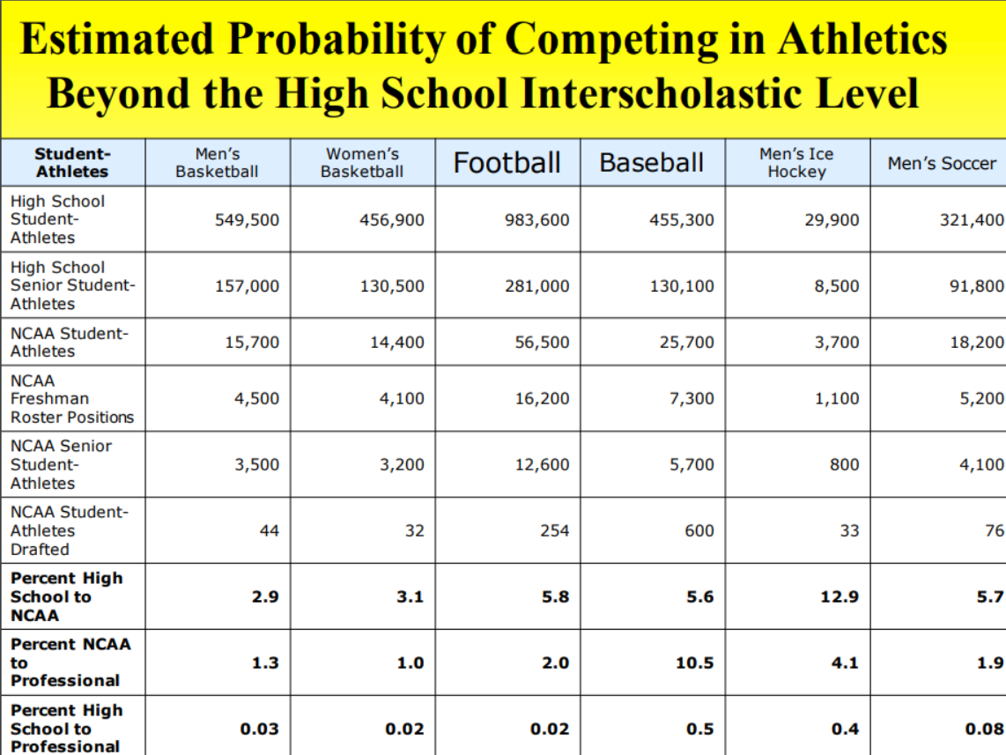
How Do I Help Myself?
Be Proactive!!!
Create a one page resume – send to school with link to highlight film
Height/Weight/Strength/Speed
Grades with Core GPA
Composite ACT Score/SAT score
Character Info

Slide 14
Where Can I Play?
Be REALISTIC
Ask your coach what level you might be able to play
Go online and check out the roster
Do I match the height/weight of the players at my position?
Google the highlight films of the players on the roster – Do I play at the same speed and have the same skill?
Attend camps and or combines and compare yourself against others with offers
OL
6’4 302
SUB 5.4
DL
6’4 285
SUB 5.0
LB
6’2 227
SUB 4.7
RB
5’11 207
SUB 4.5
TE
6’4 245
SUB 4.7
WR
6’1 188
SUB 4.6

Slide 15
NCAA Recruiting Timeline
The recruiting process for most Division I athletes usually begins during their Sophomore year of High School. No contact does not mean no chance of Scholarship.
The following information is for only Division 1 football programs all FCS/D2/D3/NAIA/JUCO programs begin recruiting much later (Junior/Senior Year).
Freshman/Sophomore Year – Division I
Materials – You may receive brochures for camps and questionnaires
Calls – You may make calls to coaches at your expense only. (Coaches cannot contact you.)
Off Campus contact – NONE
Official Visits – NONE
Unofficial Visit – You may make unlimited unofficial visits.

Slide 16
NCAA Recruiting Timeline
Junior Year - Division I
Materials – You may begin receiving mailed letters/other materials in September
Calls – You may make calls to coaches at your expense only.
Coaches may contact you once in May of this year.
Off Campus Contact – NONE
Official Visits – NONE
Unofficial Visit – You may make unlimited unofficial visits.
Senior Year – Division I
Calls – You may make calls to coaches at your expense. Coaches may contact you once per week beginning September 1.
Off Campus Contact – Allowed beginning November 27.
Official Visits – Allowed beginning in the Spring/Summer/Fall/Winter. Limit 1 official visit per college, Maximum of 5 Colleges, this includes D1&D2.
Unofficial Visit – You may make unlimited unofficial visits.
Evaluation & Contacts – Up to six times during your senior year.
6 Times you or your parents can be contacted (including evaluation off campus), that includes only one evaluation between September – November

Slide 17
College One Day Camps
Communicate all visits/camps with Coach McIntyre – These are TRYOUTS! Be ready to Run, Work & Fight for Reps
Attend camps at schools you and your coaches think you have an opportunity to play for
9th/10th graders choose dream schools but don’t ignore the smaller schools at the camp
11th/12th graders begin to choose schools who are communicating with you.
Talk to Coach Mac about camps, we will help you create a plan this meeting will be during spring football.
Bottom line schools want to watch you work out and interact with you in person, then offer or move on to the next prospect
All schools have “Junior Days” in the spring – Develop Relationships
If you are really interested in a school, you need to go!
Information will be available on each school website
If you are interested in going to a school, you need to also need to go to their summer camp. Save money by going to a one day camp for $25-$35 rather than a week-long camp for $350.

Slide 18
Winter Combines
These are combines hosted by recruiting services including 247 or Rivals. They can also be hosted by apparel companies including Under Amour or Nike, etc.
We support you going to these events and showcasing your skills. Be prepared to compete at your very best.
These combines can be both good and bad for a recruit. A prospects recruiting can pick up with a strong showing but also the opposite can also happen. A poor posted time in the 40 or other event can have very negative effects on recruiting.
If you go to a winter combine and you do not run well – make sure that your times are not posted! Times are still mailed out through subscriptions the Colleges pay for.

Slide 19
Pay Recruiting Services
If you want something done right you do it yourself with your coaches assistance .
Don’t fall victim to hearing what you WANT to hear.
These services can provide value but they are still going to require you to do the work.
Our coaches are here to support you in this process and we absolutely recommend spending your money on going to visit colleges!

Slide 20
Highlight Films
No Music
Best 10 plays first
Circle yourself – unless you are a QB
No instant replays or Slow-motion
No more than 4 minutes – Not every tackle/catch is a highlight. You would rather have 10 great clips than 50 average. You want to peak the coaches interest.
After you have tagged your film, please speak with Coach McIntyre to assist you with ensuring your clips are in the correct order.

Slide 21
How do I help Myself… Social Media
Your Twitter/Instagram/SnapChat/Facebook profiles are your resumes to recruiters. THIS IS WHERE RECRUITERS GET TO KNOW YOU! If/When they are recruiting you. These platforms are the primary way that a recruiter gets to know who you are since he does not know you or get to interact with you very much.
These platforms are used for 1 on 1 communication
If a coach follows you or DM’s you, that is a good thing. They are recruiting you and have begun to evaluate you.
Consistently communicate with coaches who have shown interest.
Three years ago, Scott Fitch couldn't believe what he was hearing. A college coach recruiting two of his Fairport High School boys basketball players called to say how much he liked what he saw after watching them play an AAU game, and that he thought both were good enough to see court time on his team as freshmen. "But we're going to stop recruiting one of them," the college coach said. Stunned, Fitch asked why. "We found his Twitter account, looked through it and some of what we saw isn't representative of what our university is about," the recruiter explained.
"Never let a 140 character tweet cost you a $140,000 scholarship"

Slide 22
Social Media

Slide 23
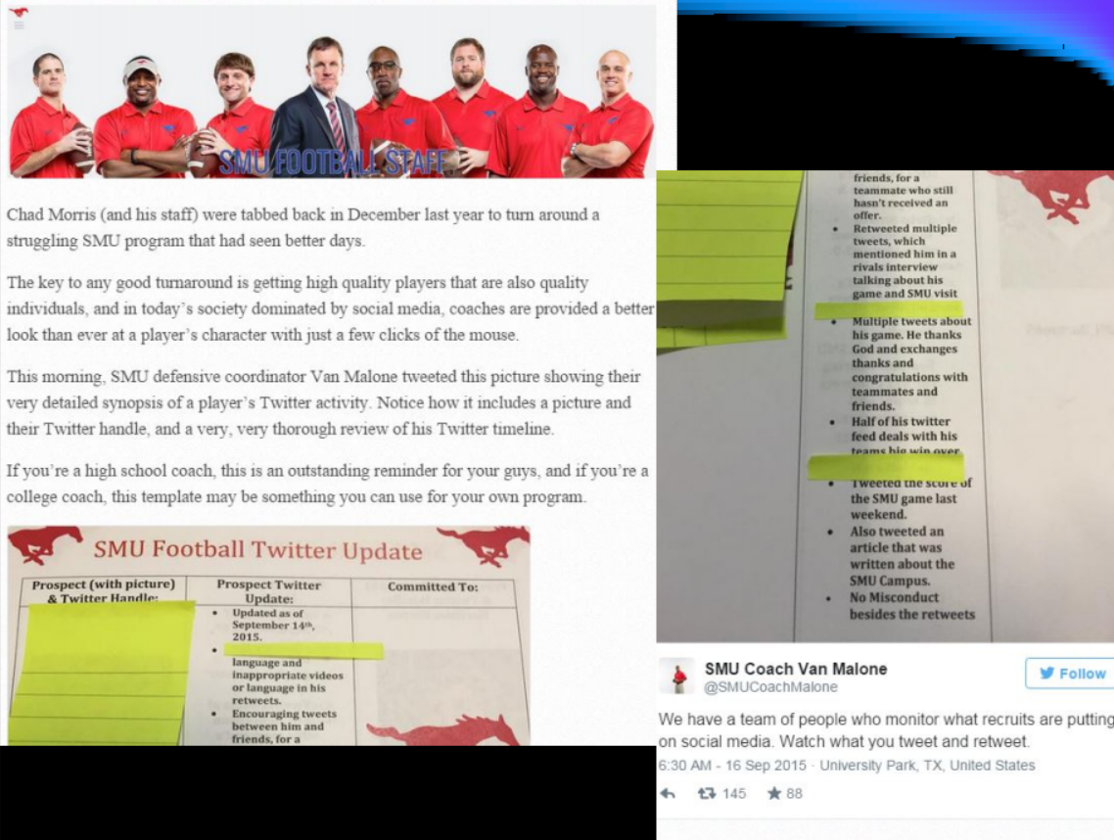
Social Media

Slide 24
How Do I Help Myself?
Be Proactive!!! Take Action
Keep your coaches informed
Create a one page resume – send to school with link to highlight film
Height/Weight/Strength/Speed
Grades with Core GPA
Composite ACT Score/SAT score
Character Info
Be organized and have a plan. Research colleges that interests you.
Make your grades! Do as well as you possibly can in all your classes.
Have a great off-season. Improve as much as possible.
Sign up to take the tests. Let us know when you get your scores in.
Be realistic in your expectations.
Keep the TEAM first and remember that the more success we have as a TEAM, the more rewards there are for everyone. The further we go in the playoffs, the more exposure you will get.
Represent yourself well when coaches come on campus. Spring football is big.

Slide 25
What Should I do? Athlete
Freshmen Year
GRADES!!!!
Lift and Train Speed/Agility
Create highlight film (only very best plays, could be 7 clips or less)
Create a twitter account – it should include your real name, link to your film in Bio, your graduation year, position, and any other important info.
Sophomore Year
GRADES!!!!
Create highlight film
Contact schools you are interested in that you & your coaches think you have a realistic chance of playing for and inquire about unofficial visits – email/twitter
Start preparing for the ACT and SAT (Prep Courses)
Take the SAT or Act before your Sophomore year ends
Possibly… Attend a few winter camps/combines/showcases to understand where you fit and how to compete at 1 day events.
Pick 3-4 summer one day camps you want to attend and go see how you compare to the guys they are recruiting.
Search colleges website and fill out their online football prospect questionnaire

Slide 26
What Should I do? Athlete
Junior Year
GRADES!!!!
Contact schools you are interested in that you and your coaches think you have a realistic chance of playing for and inquire about Junior Days and unofficial visits
Create 1 page resume… send film/grades/test scores to schools at all levels that your academics fit (FBS, FCS, D2)
Search college website and fill out their online football prospect questionnaire
Follow coaches on Twitter
Take the SAT or Act 2-3 times before your Junior year ends
Pick 3-4 summer one day camps you want to attend and go see how you compare to the guys they are recruiting
Register with the NCAA Eligibility Center formerly “The NCAA Clearinghouse”

Slide 27
What Should I do? Athlete
Senior Year
If you have offers from FBS and or FCS schools you will be taking official visits to make your final decisions. Finalize Eligibility center and academic qualification details.
Not offered by SEC/ACC– probably not likely to happen unless some prior communication between you and the school has occurred.
Mid level D1 FBS schools such as GA Southern/GA State and FCS schools will continue to evaluate and offer scholarships April thru December. Recruitment, communication and evaluation will be ongoing.
D2/D3/NAIA don’t really get started with offers until November/December so they can see what has trickled down from the bigger programs visits start in January and can run into February and March. These will be financial aid packages based on academic, athletic, and need based money.

Slide 28
What Should I do? Parent
Be supportive! Each child’s recruitment is unique.
This is your son’s decision but you are there to guide him.
Help your child find the right fit from an academic and athletic standpoint.
Remember this is a 40 year decision not a 4 year decision.
When you go to a school, the coaches are evaluating you and your family as well as the athlete. They want to know everything about the kid they are getting and how he will fit into their program. Be genuine in your conversations.
Educate yourself on the schools and coaches you will be visiting.
Ways to assist your son
MONITOR HIS GRADES – Especially CORE Courses. This will pay for itself down the road. A’s/B’s are scholarship money.
Get your child ACT/SAT Prep.
Make sure they are as physically prepared to compete both in the season (offseason goals for weight/strength) and at college camps (rest/hydration).

Slide 29
Potential… Parent Questions for Colleges
What does the scholarship pay for?
How long is the scholarship for?
What kind of academic support do you give the players?
Where is my son on your recruiting board?
What is the time commitment for football versus academics?
What majors do you offer in his field? Do any other guys on the team major in that?

Slide 30
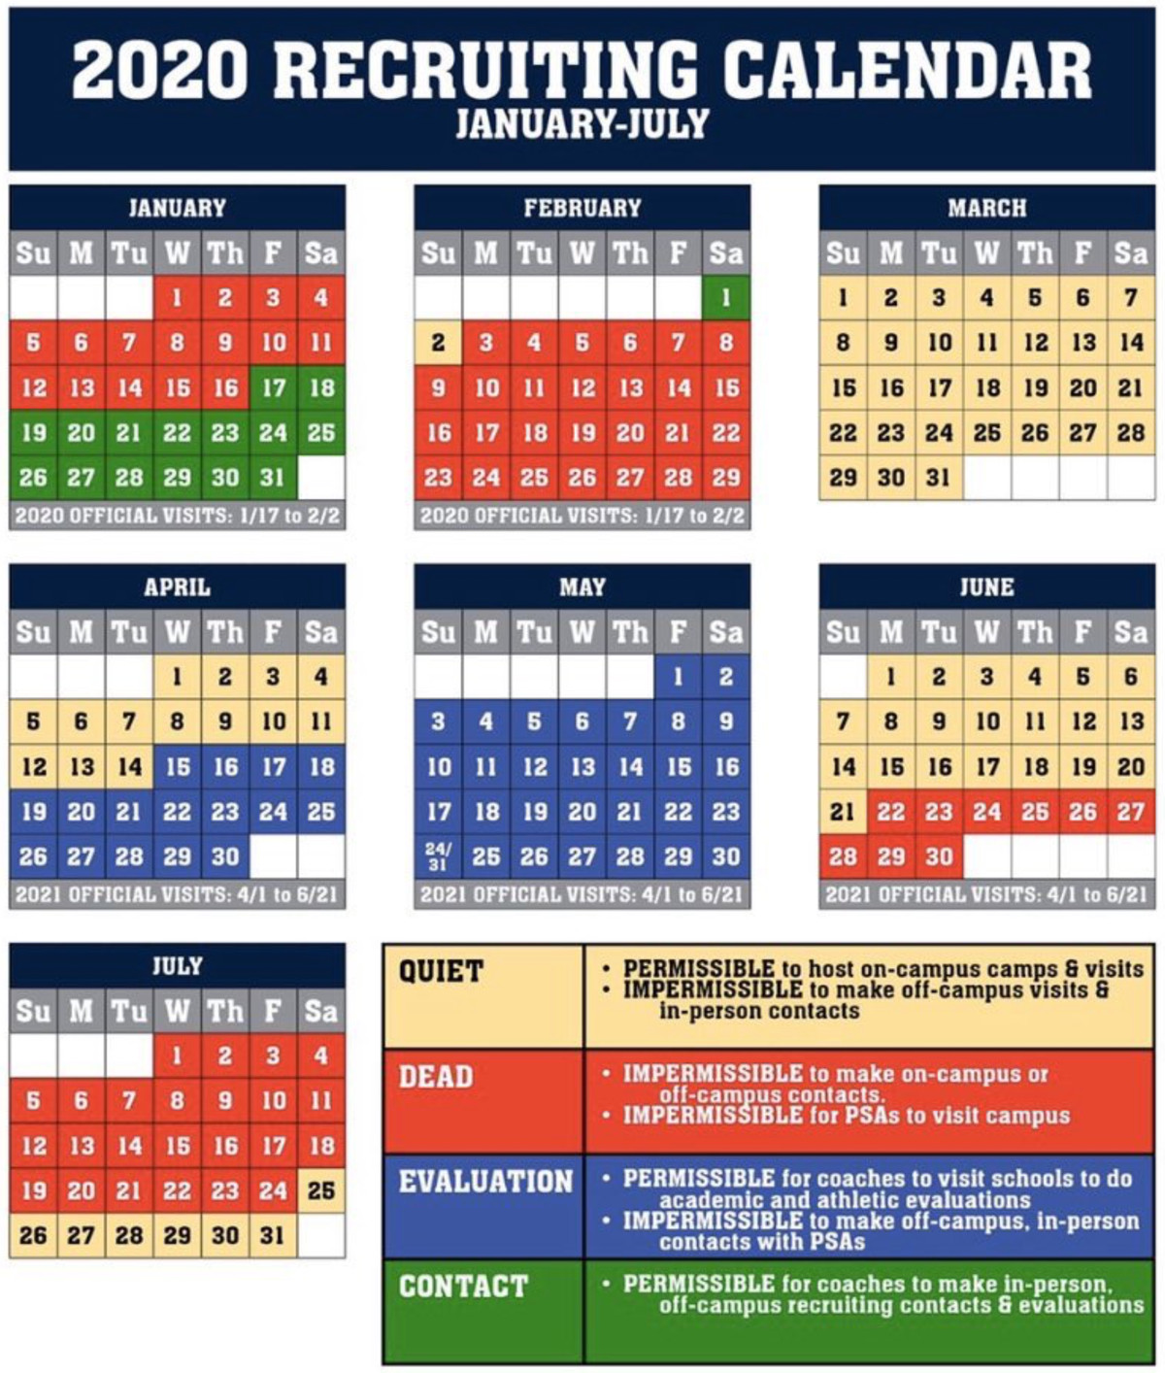

Slide 32
Bottom Line
Be Proactive!
Recruit the school you want to go too.
Schools cannot call you back but you may call them as many times as you wish – visit too!
Find a school where you will be comfortable if football goes away.
This is a 40 year decision, not 4 or 5 years.

Slide 33
Thanks for your time and attention
Are there any Questions?
Go Knights #WorkToWin #ALLIN2019

